Slide 1
Lecture 4
Displaying Quantitative Data with Graphs
Ref: Introduction to Statistics and Data Analysis
The Practice of Statistics

Slide 2
Learning Objects:
Make and interpret dotplots, stemplots and histograms of quantitative data

Slide 3
Dotplot 点图：适用于小批量数据
横轴：variable的取值
How good was the 2012 U.S. women’s soccer team? With players like Abby Wambach, Megan Rapinoe and Hope Solo, the team put on an impressive showing en route to winning the gold medal at the 2012 Olympics in London. Here are data on the number of goals scored by the team in the 12 months prior to the 2012 Olympics. 1 3 1 14 13 4 3 4 2 5 2 0 4 1 3 4 3 4 2 4 3 1 2 4 2

Slide 4
Dotplot 点图：适用于小批量数据
横轴：variable的取值
How good was the 2012 U.S. women’s soccer team? With players like Abby Wambach, Megan Rapinoe and Hope Solo, the team put on an impressive showing en route to winning the gold medal at the 2012 Olympics in London. Here are data on the number of goals scored by the team in the 12 months prior to the 2012 Olympics.（注意！尽量描述全面） 1 3 1 14 13 4 3 4 2 5 2 0 4 1 3 4 3 4 2 4 3 1 2 4 2
Steps in making a dotplot: 1. Draw a horizontal axis (a number line) and label it with the variable name.
2. Scale the axis.
3. Mark a dot above the location on the horizontal axis corresponding to each data value.

Slide 5
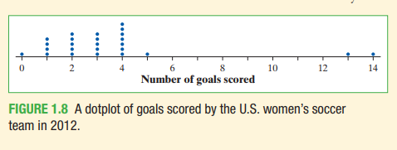
Dotplot 点图
1 3 1 14 13 4 3 4 2 5 2 0 4 1 3 4 3 4 2 4 3 1 2 4 2
Steps in making a dotplot: 1. Draw a horizontal axis (a number line) and label it with the variable name.
2. Scale the axis.
3. Mark a dot above the location on the horizontal axis corresponding to each data value.

Slide 6
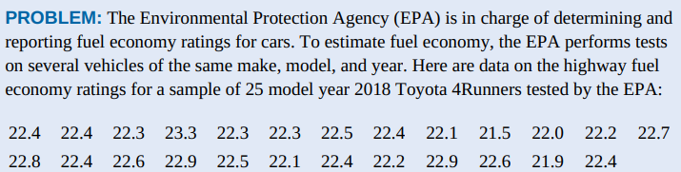
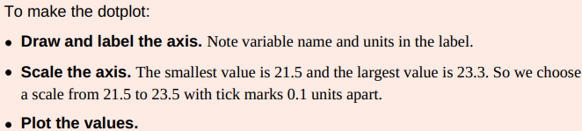
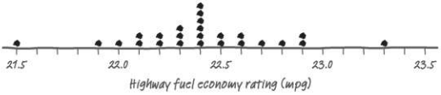
Make a dotplot of these data.

Slide 7
Stemplots (Stem-and-Leaf Plots) 茎叶图
These data represent the responses of 20 female students to the question, “How many pairs of shoes do you have?”
Construct a stemplot.
50 | 26 | 26 | 31 | 57 | 19 | 24 | 22 | 23 | 38
13 | 50 | 13 | 34 | 23 | 30 | 49 | 13 | 15 | 51
Separate each observation into ：
a stem (all but the final digit). For these data, the tens digits are the stems, e.g. 5 of 50, 2 of 26, 3 of 31, etc.
a leaf (the final digit). For these data, the ones digits are the leaves, e.g. 0 of 50, 6 of 26, 1 of 31, etc.
1
2
3
4
5
1 93335
2 664233
3 1840
4 9
5 0701
1 33359
2 233466
3 0148
4 9
5 0017
Key: 4|9 represents a student who reported having 49 pairs of shoes.
Stems
Add leaves
Order leaves
Add a key
5. Provide a key that explains in context what the stems and leaves represent.
3. Write each leaf in the row to the right of its stem.
4. Arrange the leaves in increasing order out from the stem.
2. Write all possible stems from the smallest to the largest in a vertical column and draw a vertical line to the right of the column.

Slide 8
Stemplots (Stem-and-Leaf Plots) 茎叶图
50 | 26 | 26 | 31 | 57 | 19 | 24 | 22 | 23 | 38
13 | 50 | 13 | 34 | 23 | 30 | 49 | 13 | 15 | 51
1 33359
2 233466
3 0148
4 9
5 0017
Key: 4|9 represents a female student who reported having 49 pairs of shoes.
small data set
a quick picture of the distribution
actual numerical values

Slide 9
Split stemplot & Back-to-back stemplot
When data values are “bunched up”, we can get a better picture of the distribution by splitting stems.
50 | 26 | 26 | 31 | 57 | 19 | 24 | 22 | 23 | 38
13 | 50 | 13 | 34 | 23 | 30 | 49 | 13 | 15 | 51
Females
333
59
2334
66
014
8
9
001
7
split stems
1
1
2
2
3
3
4
4
5
5
1 33359
2 233466
3 0148
4 9
5 0017
Key: 4|9 represents a student who reported having 49 pairs of shoes.
Key: 4|9 represents a student who reported having 49 pairs of shoes.

Slide 10
Split stemplot & Back-to-back stemplot
Two distributions of the same quantitative variable can be compared using a back-to-back stemplot with common stems.
Females
Males
50 | 26 | 26 | 31 | 57 | 19 | 24 | 22 | 23 | 38
13 | 50 | 13 | 34 | 23 | 30 | 49 | 13 | 15 | 51
14 | 7 | 6 | 5 | 12 | 38 | 8 | 7 | 10 | 10
10 | 11 | 4 | 5 | 22 | 7 | 5 | 10 | 35 | 7
Females
333
95
4332
66
410
8
9
100
7
Males
0 4
0 555677778
1 0000124
1
2 2
2
3
3 58
4
4
5
5
Interesting inference?
Key: 4|9 represents a student who reported having 49 pairs of shoes.

Slide 11
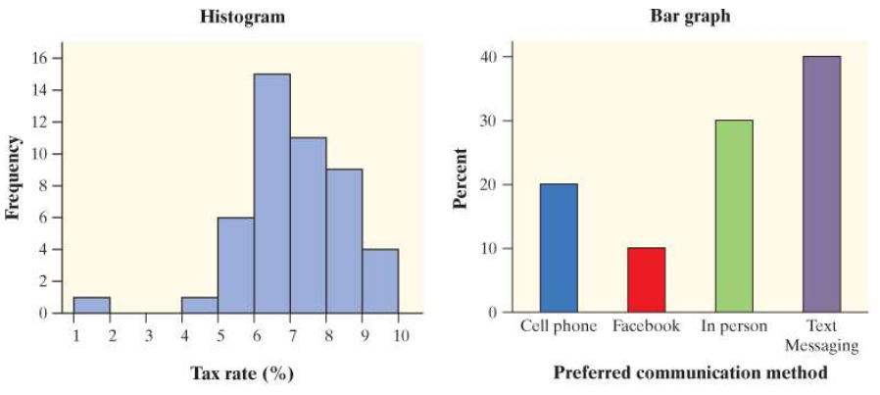
Histograms resemble bar charts closely.
One main difference:
- histograms: bars touching each other, with no
spacing in between.
- bar charts: have spaces to separate the bars.

Slide 12
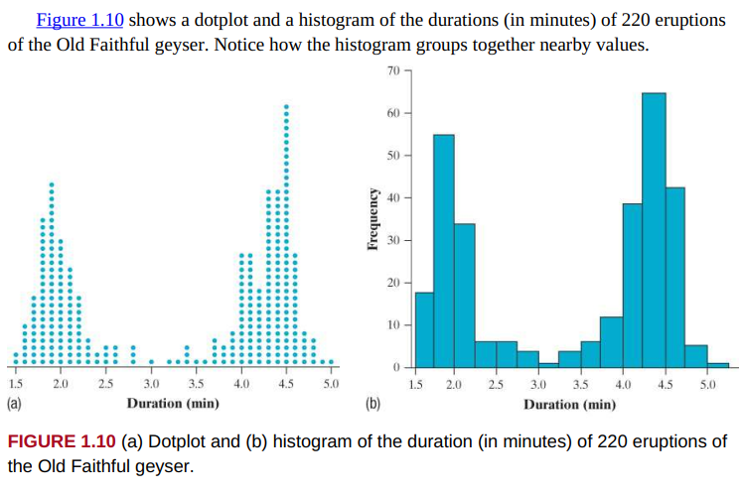

Slide 13


Slide 14
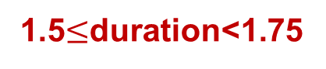
1.5$≤$duration<1.75

Slide 15
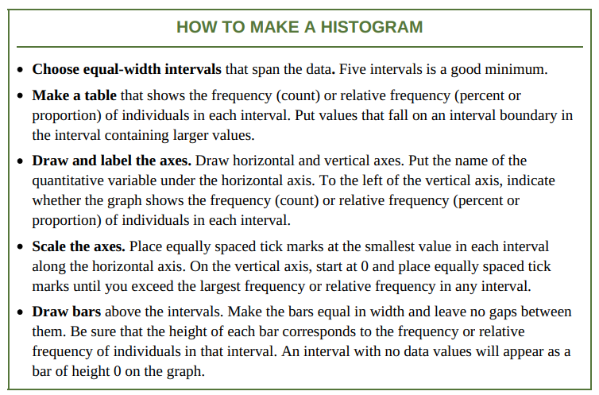

Slide 16
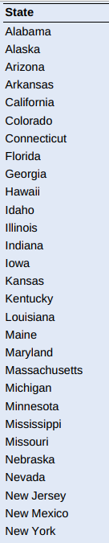
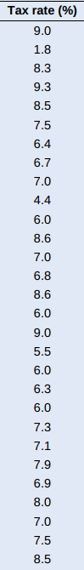
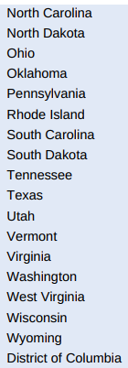
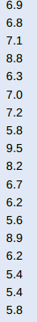
Sales tax rates vary widely across the United States. Four states charge no state or local sales tax: Delaware, Montana, New Hampshire, and Oregon. The table shows data on the average total tax rate for each of the remaining 46 states and the District of Columbia.

Slide 17
Make a frequency histogram to display the data of the following 46 states.

Slide 18
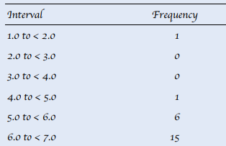
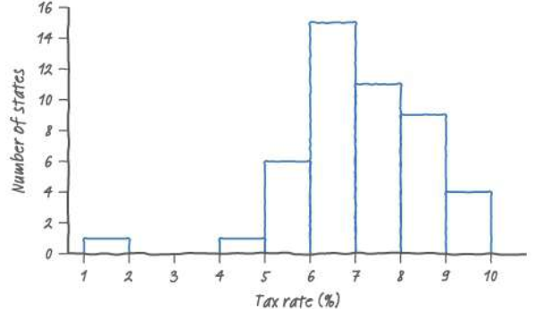
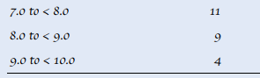

Slide 19
What percent of values in the distribution are less than 6.0? Interpret this result in context.
8/47 = 0.170 = 17.0%
17% of the states (including the District of Columbia) have tax rates less than 6%.

Slide 20
Histograms： "sorting bins“
- sort data by placing them into "bins"
- count how many pieces of data are in each bin
- the height of the rectangle is proportional to the number of pieces in that bin
- "How many measurements are there in each of the classes of measurements?"
Bar graphs
You have several measurements of different items, and you compare them.
- "What is the measurement for each item?”

Slide 21
Situation | Bar Graph or Histogram ?
We want to compare the total revenues of five different companies.
We have measured revenues of several companies. We want to compare numbers of companies that make from 0 to 10,000; from 10,000 to 20,000; from 20,000 to 30,000 and so on.
We want to compare heights of ten oak trees in a city park.
We have measured several trees in a city park. We want to compare numbers of trees that are from 0 to 5 meters high; from 5 to 10; from 10 to 15 and so on.
Bar graph
Histogram
Bar graph
Histogram

Slide 22
Bin size
What bin size should you use?
- Not so detailed that it is no longer a summary
- Not overly summarized that you loose all the information
It is an iterative process – try and try again.
➔ start with 5 to10 bins
Look at the distribution and refine your bins
(There isn’t a unique or “perfect” solution)

Slide 23
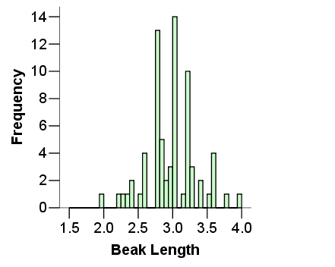
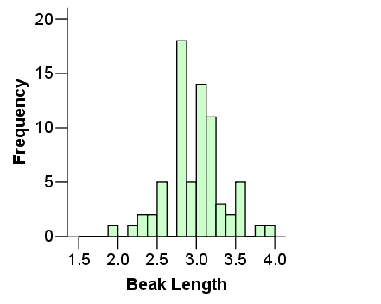
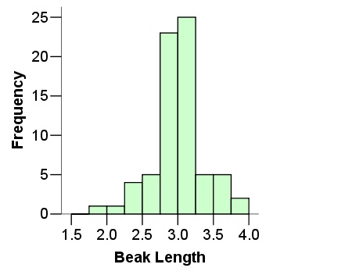
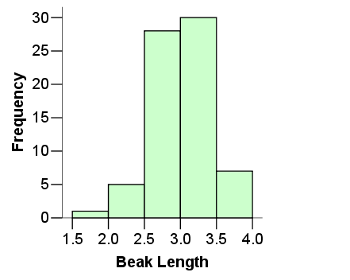
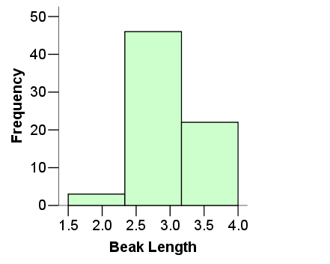
Same data set
Not summarized enough
Too summarized

Slide 24
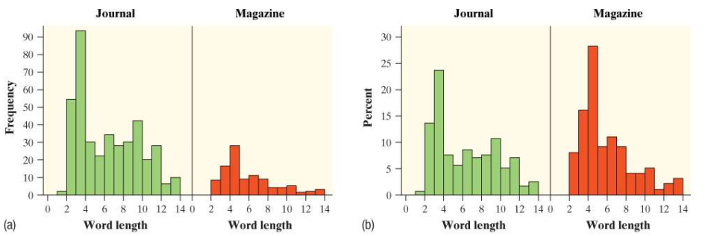
Use percents or proportions instead of counts on the vertical axis when comparing distributions with different numbers of observations.
- comparing the reading levels of a biology journal and an airline magazine
- count the number of letters in the first 400 words of an article in the journal and of the first 100 words of an article in the airline magazine
The left figure is misleading!!!!!!!!!

Slide 25
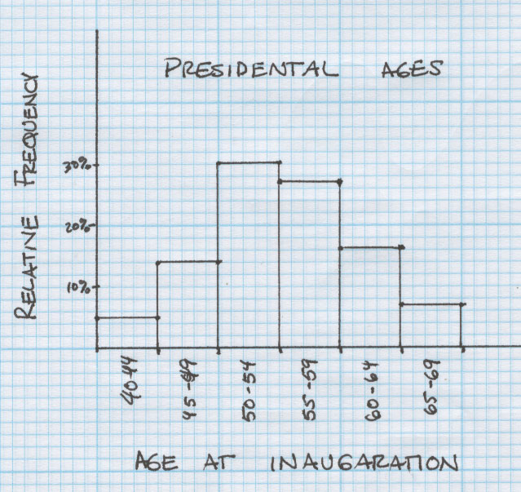
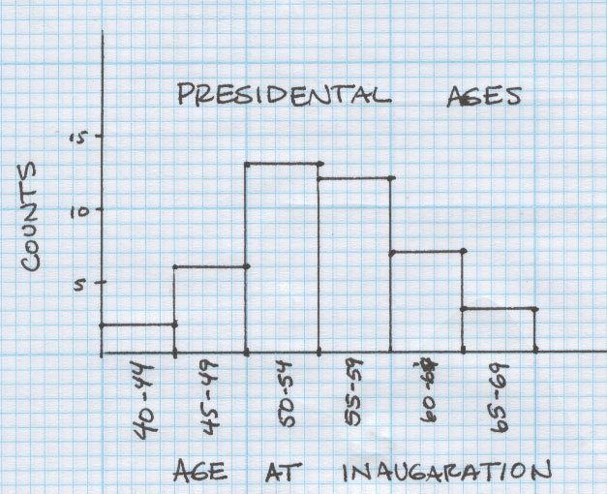
Notice the shape does not change when comparing frequency and relative frequency Histograms

Slide 26
Summary
Dotplot:
Display individual values on a number line
Stemplot:
Separate each observation into a stem and a leaf
Histogram:
Frequencies (counts) or relative frequencies (proportions or percents) of values in equal-width intervals
Remember:
Histograms: quantitative data; bar graphs: categorical data.
When comparing data sets of different sizes → Relative frequencies

